Slide 1
DATA-LA 485
Intro to Project #1

Slide 2
Group 1:
Terry
Tuan
Kyle
Group 2:
Cameron
Ryan
Kamryn

Slide 3
One more look at the data
Variables:
https://www.drivendata.org/competitions/7/pump-it-up-data-mining-the-water-table/page/25/
Data Format:
Training set values – the variables that you’ll use to train your model
Training set labels – the labels that you’re training your model to detect
Test set values – the variables that you’ll use to make final predictions
Note: There are no test set labels – you’re going to be blind about your model’s final performance, so I suggest evaluating your model’s performance on your training set labels quite thoroughly.

Slide 4
Understanding the Context of the Data
https://www.andrew.cmu.edu/user/kdagrawa/documents/waterpump.pdf
Googling the TAARIFA data can give you a number of sources and ‘solutions’ to the issue (with varying degrees of accuracy). Most published solutions will be more advanced than I’m asking you to create, but you could take some inspiration from them.

Slide 5
Steps to Data Analysis…
Take a few minutes to write down the steps you would perform to execute this problem (perhaps even just a first pass)
Understand the context
Create test / train datasets
Look at the variables
Missing values
Distributions
Outliers
Which variables do you want to use (feature selection)? Do you want to create new variables (feature engineering)?
Create model(s); optimizing tuning parameters
Make predictions on test dataset
Iterate – how can you make things better?

Slide 6
Data exploration
What do the variables measure?
table(train_set$Variable)
hist(train_set$Variable)
summary(train_set$Variable)
group_by(Variable) %>% summarize(Mean_Col = mean(Variable)

Slide 7
Some things to consider during early data exploration:
* Is this variable independent from other variables, or correlated with some? (a correlation matrix or plot can help with this, as long as you aren’t trying to compare too many variables)
* Is the variable I am trying to understand categorical or continuous? Or somewhere in between? (Likert data, for example)
* Are my independent (predictor) variables categorical or continuous?
* Are my continuous variables normally distributed? (A LOT of traditional statistical methods expect this – important to check)

Slide 8
Feature Selection
Determining which predictors should be included in a model is becoming one of the most critical questions as data are increasingly high-dimensional.
It would be useful to:
Remove predictors that are not informative
Remove predictors that are highly correlated with other predictors.
Some models are naturally resistant to non-informative predictors, such as: trees, rule-based models, MARS (multivariate adaptive regression splines)

Slide 9
Filter Methods
Filter methods evaluate the predictors prior to training the model, and based on this evaluation, a subset of predictors are entered into the model.
If you do a bunch of t-tests, then recognize that the problem of multiplicity occurs (you increase your false-positive or family-wise error rate). You may want to have a Bonferroni correction
out <- t.test(x ~ y)$p.value
out <- fisher.test(factor(x), y)$p.value

Slide 10
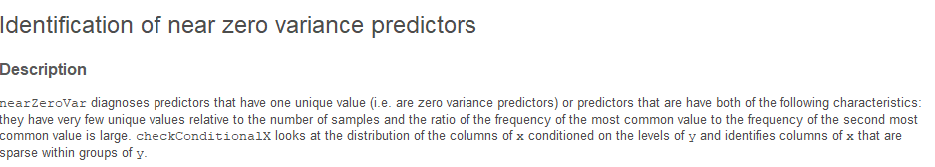
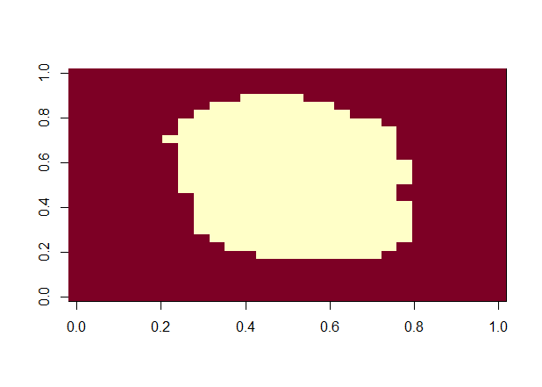
Preprocessing
Before running any analyses, we want to
a) Remove those with very little variation
We can use the function nearZeroVar()
b) Exclude predictors that are not useful.
nzv <- nearZeroVar(dataframe)
nzv
col_index <- setdiff(1:ncol(dataframe), nzv)
col_index
length(col_index)

Slide 11
Test/Train datasets
You may want to split your training data again into test/train datasets (or bootstrap resamples) so you can ‘test’ your model without using your valuable test data.
library(tidymodels)
X ← initial_split(data)
test_set <- testing(X)
train_set <- training(X)

Slide 12
Dealing with Missing Values
Many of our models will struggle to deal with missing values. There will be missing values in your dat.
For instance, you cannot make a prediction using a logistic regression model if one of the predictor variables is missing.
But not all – tree-based models can deal with missing values.
It is important to understand why you have missing data
You should try to figure out the pattern of missingness. It is possible that there are patterns to missingness – for instance, who is willing to fill out a survey for a particular thing?
How to deal with missingness?
Eliminate the predictor
Removal of the sample
Imputation – use information from other predictors to estimate the values of other predictors.

Slide 13
Imputation
Use the training set to build an imputation model for each predictor in the data set.
Missing values are filled in using imputation
Model training can begin
If you are using resampling to tune parameters, then imputation should be incorporated into the resampling.

Slide 14
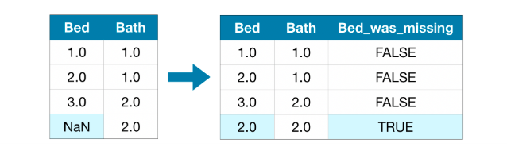
Types of Imputation
Mean imputation – filling in the missing value with the mean of that column.
The imputed value won’t be exactly right – but it usually leads to more accurate models than you would get from dropping the column entirely
Determine if there is another variable that is highly correlated. Use that variable to create a simple linear regression predict the missing values.
K-nearest neighbors – a new sample is imputed by finding the samples in the training set “closest” to it and averages these nearby points to fill in the value.
We can also impute and then create another predictor variable that indicates whether or not the variable was missing

Slide 15
Let’s look at an example variable
How many ages are missing?
sum(is.na(train_set$Variable)) #~90
Imputing:
Mean
train_set$Variable[is.na(train_set$Variable)] <- mean(train_set$Variable, na.rm = TRUE)
OR
train_set %>% mutate(Variable = ifelse(is.na(Variable), mean(Variable, na.rm=TRUE), Variable)
Of course, one of the problems is that you have missing values in your test data as well – so you’ll need to impute both the test & train dataset (we may want to combine our datasets to do this).

Slide 16
kNN imputation
library(tidymodels)
# define the recipe
diabetes_recipe <-
# which consists of the formula (outcome ~ predictors)
recipe(diabetes ~ pregnant + glucose + pressure + triceps +
insulin + mass + pedigree + age,
data = diabetes_clean) %>%
# and some pre-processing steps
step_normalize(all_numeric()) %>%
step_knnimpute(all_predictors())

Slide 17
Correlation
* Correlation is not a hypothesis test – it doesn’t say whether your relationship is significant or not, but
It does point to the strength of the relationship.
* You can only check correlation between continuous variables. You also have to address missing variables,
Either by removing them, or specifying that you only want to use complete pairs to calculate your correlation.
Code to build a correlation matrix:
cor(df, method = "pearson", use = "complete.obs")
Code to build a correlation matrix with p-values:
library(“Hmisc”)
rcorr(as.matrix(df))
Code to build a correlation plot:
library(“corrplot”)
corrplot(df, type = “upper”, order = “hclust”, tl.col = “black”, tl.srt = 45)

Slide 18
Feature Engineering
We may want to create new features from our data.
We’ll create two features:
1) A variable: Mother which indicates a person is likely a mother
2) A variable: Father which indicates a person is likely a father

Slide 19
How to create these variables?
What characteristics / features do you think would indicate mother / father?

Slide 20
How would you go about creating this?
Think about the order in which you want to run your code – where does this feature engineering fit in?
Would this have to occur before or after imputing age?

Slide 21
WARNING: Binning Predictors is not recommended
Since many of our models can extract complex relationships (not logistic regression, but others), binning predictors is not recommended because you are losing information.

Slide 22
Creating Dummy Variables or One-Hot Encoding
Instead of just using a factor (also known as label encoding), we may want to use dummy variables (or one-hot encoding)
What is the benefit? It may allow our model to keep certain dummy categories and drop others.
#install.packages("varhandle")
#library(varhandle)
ds <- to.dummy(train_data$SibSp_cat, "sibsp")
train_set <- cbind(train_set, ds)
ds2 <- to.dummy(test_set$SibSp_cat, "sibsp")
test_set <- cbind(test_set, ds2)

Slide 23
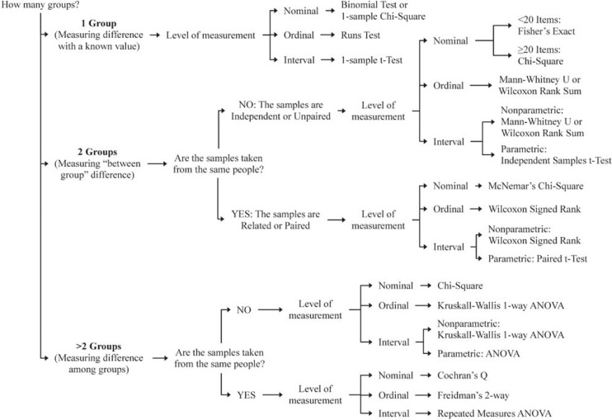
Measuring a Relationship (Hypothesis Testing)

Slide 24
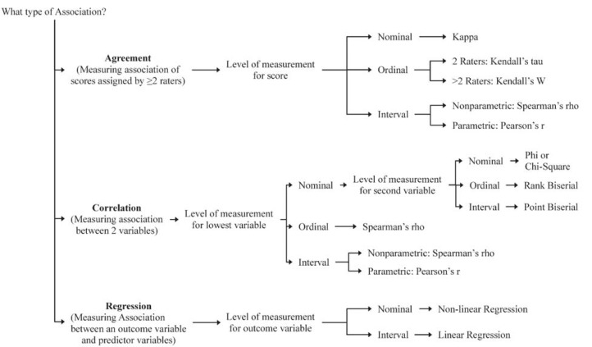
Measuring the Strength of an Association

Slide 25

Choosing a Machine Learning Model (if desired)

Slide 26
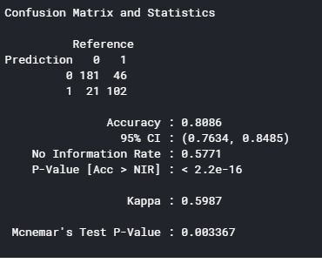
Use the imputed data to run model

Slide 27
Check accuracy on “test” data
#check accuracy score on test data
survived_hat <- predict(bestModel1, test_set, type="response")
survived_pred <- factor(ifelse(survived_hat >0.5, 1, 0))
confusionMatrix(survived_pred, factor(test_set$Survived))
survived_hat <- predict(bestModel2, test_set, type="response")
survived_pred <- factor(ifelse(survived_hat >0.5, 1, 0))
confusionMatrix(survived_pred, factor(test_set$Survived))

Slide 28
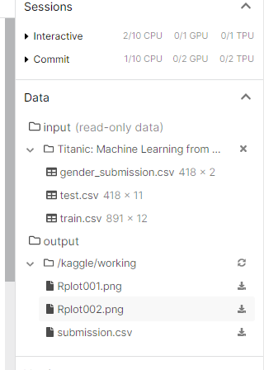
Making predictions and writing to a file
You are allowed to make 3 submissions a day for this competition (other competitions may limit you to more or fewer submissions per day)
test_labels <- predict(fit, test_data, type="response")
Specifying type as response will cause R to predict labels, rather than percentages.
submission <- test_data %>% select(UniqueID, predicted_label)
submission
write.csv(submission, 'submission.csv‘, row.names=FALSE)
You can find your file under your working directory.

Slide 29
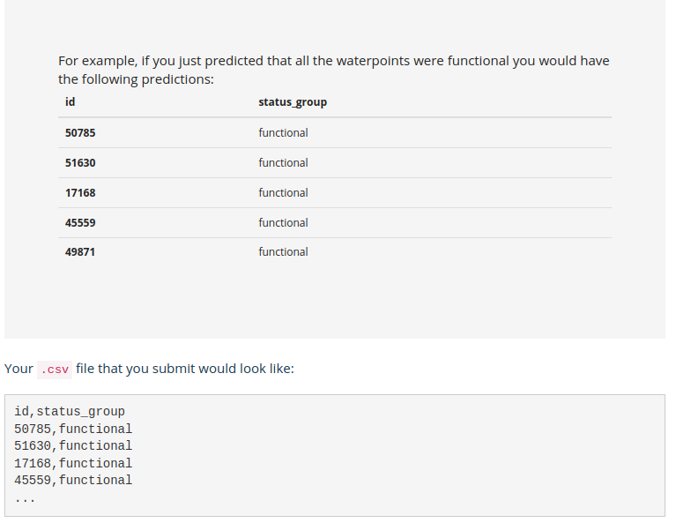
Submission Format

Slide 30
Submit your predictions
Go back to the competition
Select “Submit Predictions”
Upload your ‘submission.csv’ file
It’ll tell you your score
See your place on the leaderboard (out of 10,000 or so)

